Slide 1
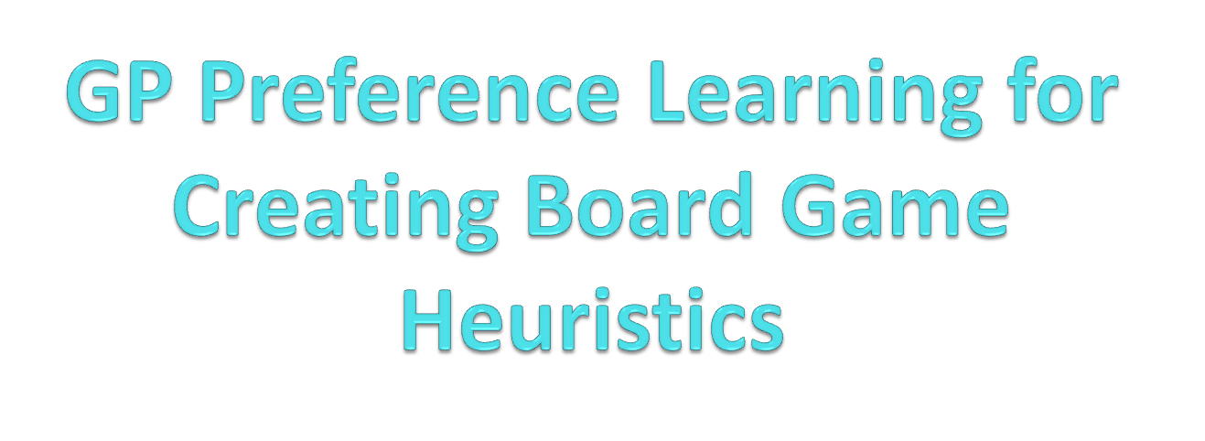
-Vignesh Rao, Y
Media Informatics

Slide 2
Phases
The Topic is Active Preference Learning using Gaussian Process for Creating Board Game Heuristics.
Board Game Heuristics.
GP Preference Learning.
Actively Learning.
Creating the best heuristic.

Slide 3
Motivation
We need a Min-Max tree to play efficiently.
Construction of this is not so easy.
  Eg: Chess (2.1 X 10⁹⁶ possible nodes).
But with the Min-Max tree of limited depth ‘d‘, we can approximate a best heuristic for a Board Game.

Slide 4
Games we use
We use certain configurations of Othello and Checkers game.
A Heuristic(row vector) is a scoring function, with which the playing agent ranks the next possible moves at the leaves of the min-max tree.
We assume that the scoring function is a linear function of the board features.

Slide 5
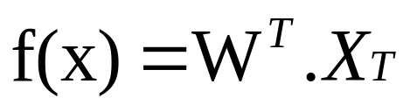
Board Game Heuristic
The Heuristic function at the leafs of the min-max tree is :
      Where,
      W is the weight vector .
      X_{T} is the game state at time T.
      -We try to learn ’W’ from the learning data

Slide 6
GP Preference Learning
A Game is simulated between H1 and H2.
H1 Vs H2
H1 won or preferred.
We can represent this by a latent function F(H), which tells the strength of the heuristic.
F(H1) > F(H2)

Slide 7
GP Prior
We assume F(H) is a Gaussian Process and learn this latent function.
Prior Mean : 0 (Zero Mean Function)
Prior Co-var : RBF Co-Variance Function.

Slide 8
Binary Classification
Let us assume function G(H,H`) and ignore F(H), such that,
G(H,H´) = F(H) – F(H´)
Now GP Prior on G is
    mu_g(h1, h2) = mu_f(h1) - mu_f(h2).
    K_g(h1, h2) = K_f(h1, h1) + K_f(h2, h2) - 2K_f(h1, h2).
So the dataset looks like
X = [H1,H2] and Y = [+1] or [-1]

Slide 9
GP Classification
We then Compute the following (using pyGPs framework),
  Likelihood Function (Probit).
    Φ (G) where Φ is Std. Gaussian cumulative distribution function.
  Posterior Approximation (EP).
  Parameter Optimization.

Slide 10
Accuracy of Learning
1000 training examples.
1000 test examples.
Each game played 3 times.
Accuracy of the Model is
  Othello : 83%
  Checkers : 82%
    This takes around 4 hours to Execute.

Slide 11
Active Learning
Goal of Active Learning is to learn efficiently with minimal data.
In our case, we should try to learn for prediction of winners from minimal but informative or significant data rather than random or repetitive data.
For this we consider the Bayesian Active Learning by Disagreement (BALD) [2] strategy for learning efficiently.

Slide 12
BALD
We need to find a heuristic pair [H1,H2] such that it maximizes the BALD Objective,
  Where, μ_{x} and σ_{x}² are mean and variance of a heuristic pair.
This Objective chooses a heuristic pair whose strength is almost equal and the model is highly uncertain about the winner (parameter space with highest uncertainty is learnt).

Slide 13
Experiment - 1
We experimented to see the effect of learning and prediction of winners at each iteration using BALD. The initial set-up of the experiment are,
Game : Othello and Checkers.
Tournament among 10 random heuristics initially.
Min-Max tree depth : 4
Number of play outs : 3
Rounds : 100

Slide 14
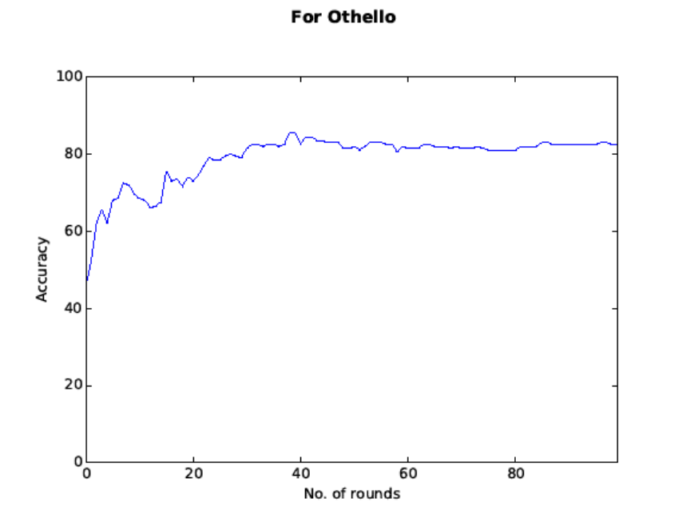
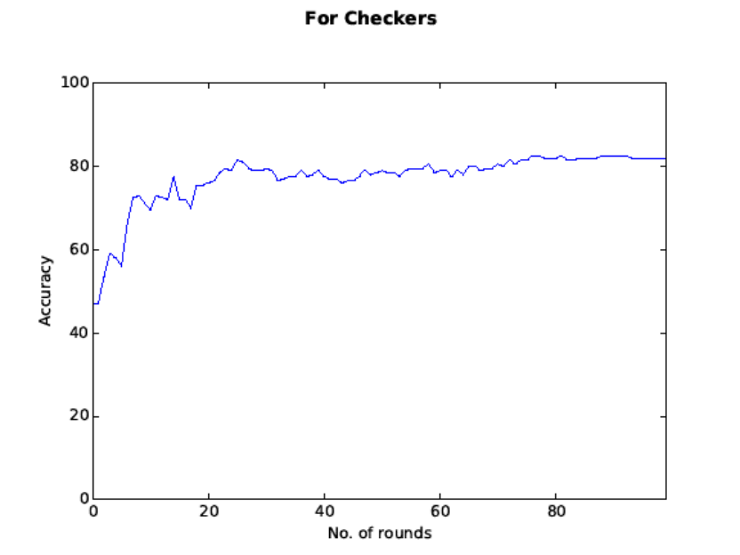
Accuracy
Accuracy is about 84% and 83% with 1000 test pairs.

Slide 15
Finding Best Heuristic.
Our Ultimate Goal is to find a heuristic of high win rate or strength.
We can measure the strength of a heuristic by benchmarking it.
We try to investigate the BALD objective(learn for efficient prediction) to come up with a best heuristic.

Slide 16
Benchmarking
To find the strength of a heuristic H, we benchmark it.
We randomly generate N opponents.
Play heuristic H Vs N opponents games.
Count the number of wins(+1) and draws(+0.5) as the score of this heuristic H.

Slide 17
Semi - BALD
We fix the first heuristic of the heuristic pair as the top scorer in the training set and then try to find its opponent.
[H_{top} , H_{BALD}]
BALD tries to find a heuristic H_{BALD} which is as strong as H_{top} / highly uncertain about the winner.
Initially, we try to learn spaces with high uncertainty and then we might get a new best heuristic as we learn iteratively.

Slide 18
Experiment - 2
We experimented to see the effect of learning and strength of a best heuristic at each iteration by Semi- BALD. The initial setup of the experiment are same as experiment except.
We fixed the first heuristic in the pair as top scorer and found its opponent.
At each round, this new opponent is played against some 5 random heuristic in training set and model is learnt.
Benchmark this new opponent with 50 Opponents.
If score is improved, assign as the best heuristic.

Slide 19
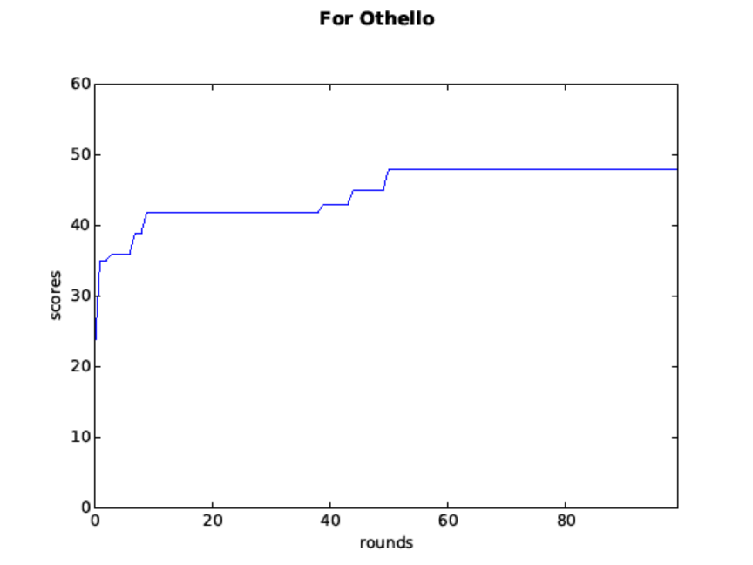
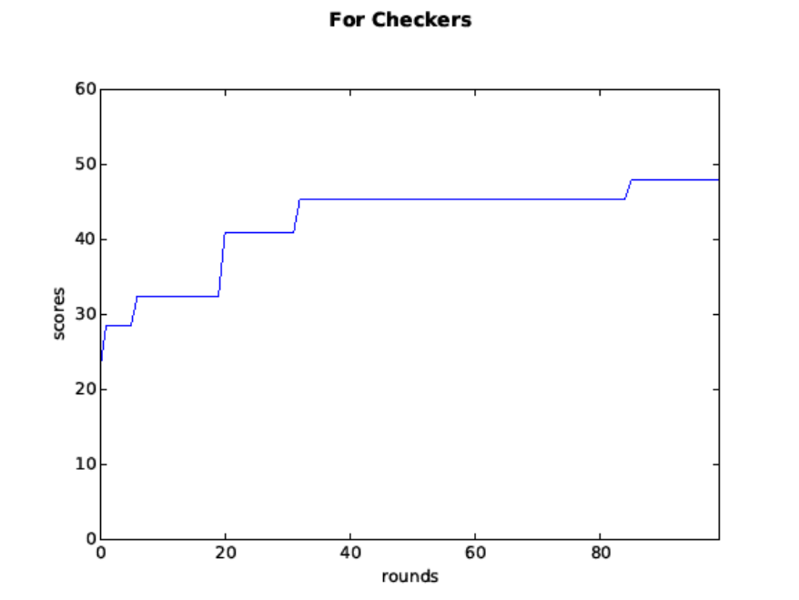
Best Heuristic´s Score
Benchmarked against 50 heuristics and the score was 47/50 and 48/50.

Slide 20
References
Chu, W., & Ghahramani, Z. (2005, August). Preference learning with Gaussian processes. In Proceedings of the 22nd international conference on Machine learning (pp. 137-144). ACM.
Houlsby, N., Huszar, F., Ghahramani, Z., & Hernández-lobato, J. M. (2012). Collaborative gaussian processes for preference learning. In Advances in Neural Information Processing Systems (pp. 2096-2104).
Eric, B., Freitas, N. D., & Ghosh, A. (2008). Active preference learning with discrete choice data. In Advances in neural information processing systems(pp. 409-416).

Slide 21
Thank You..!!

